Slide 1

Denoising Image Analysis
Undergraduate Project
MTH393A
Mentor : Dr. Tushar Sandhan
Department of EE, IITK
Dept. Mentor : Dr. BVR Kumar
Department of Math & Stats, IITK
Project Lead : Sandeep Parmar
Roll no- 210922
BS - SDS
Department of Math & Stats, IITK

Slide 2
Math Review

Slide 3
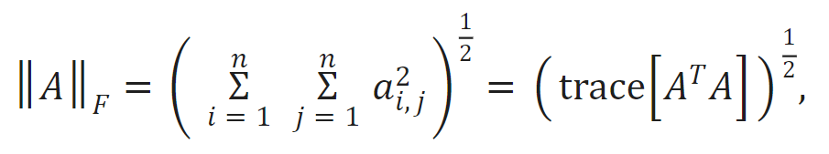
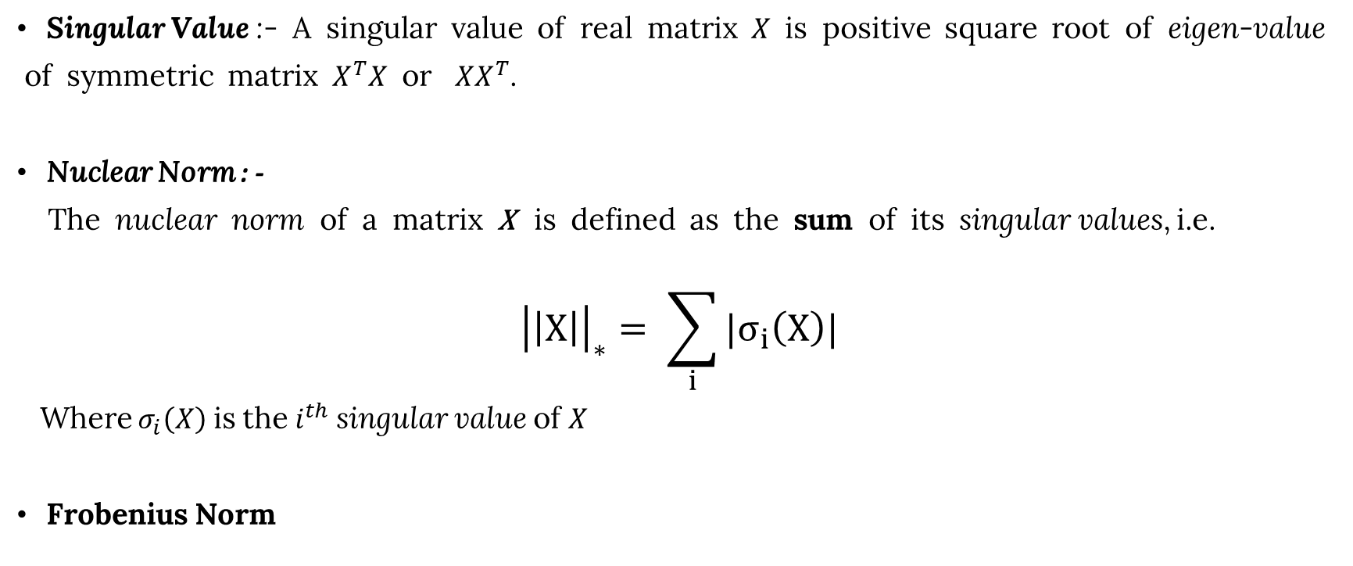
Math
Singular Value :- A singular value of real matrix $X$ is positive square root of eigen-value
of symmetric matrix $X^{T}X$ or $XX^{T}$.
Nuclear Norm : -
The nuclear norm of a matrix X is defined as the sum of its singular values, i.e.
$${\left|\left|X\right|\right|}_{∗}= \sum_{i}{|σ_{i}\left(X\right)|}$$
Where $σ_{i}\left(X\right)$ is the $i^{th}$ singular value of $X$
Frobenius Norm

Slide 4
Introduction

Slide 5
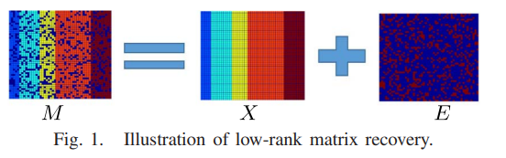
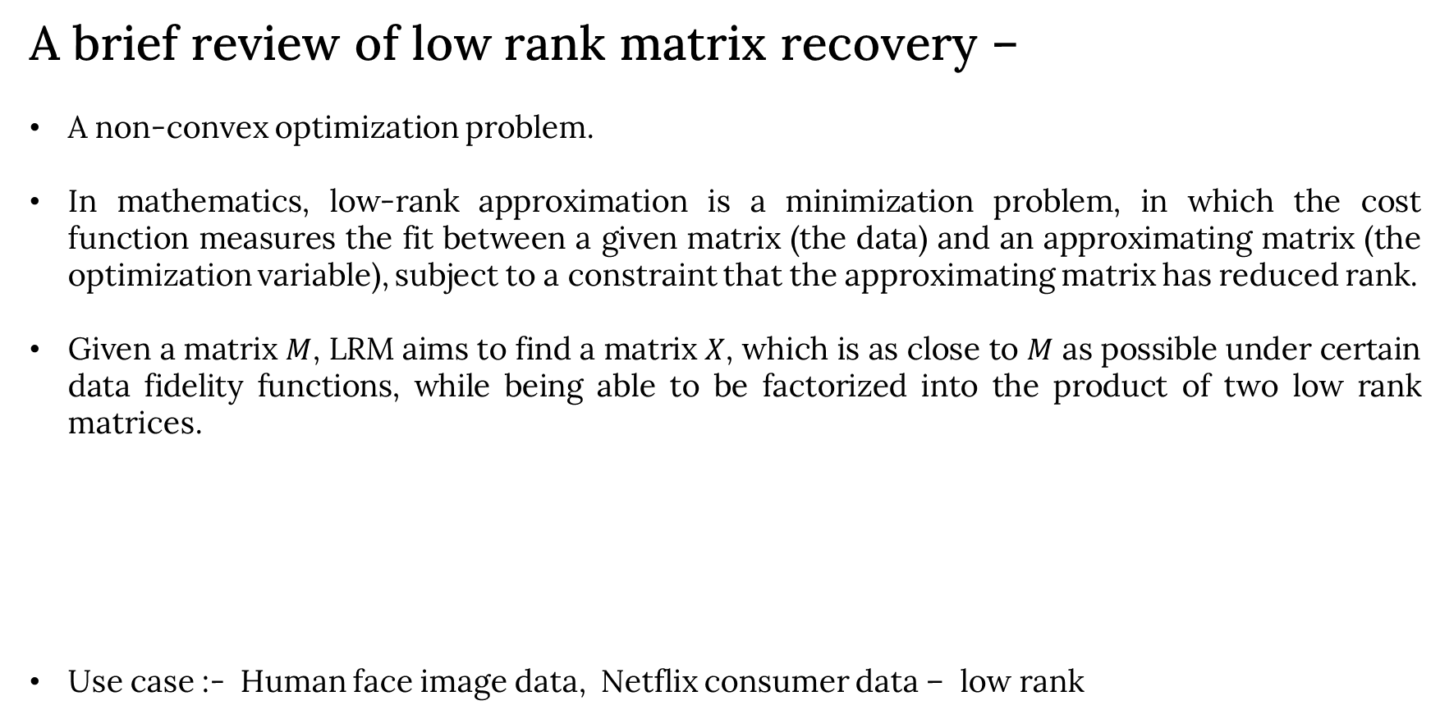
Introduction -
A brief review of low rank matrix recovery –
A non-convex optimization problem.
In mathematics, low-rank approximation is a minimization problem, in which the cost function measures the fit between a given matrix (the data) and an approximating matrix (the optimization variable), subject to a constraint that the approximating matrix has reduced rank.
Given a matrix $M$, LRM aims to find a matrix $X$, which is as close to $M$ as possible under certain data fidelity functions, while being able to be factorized into the product of two low rank matrices.
Use case :- Human face image data, Netflix consumer data – low rank

Slide 6
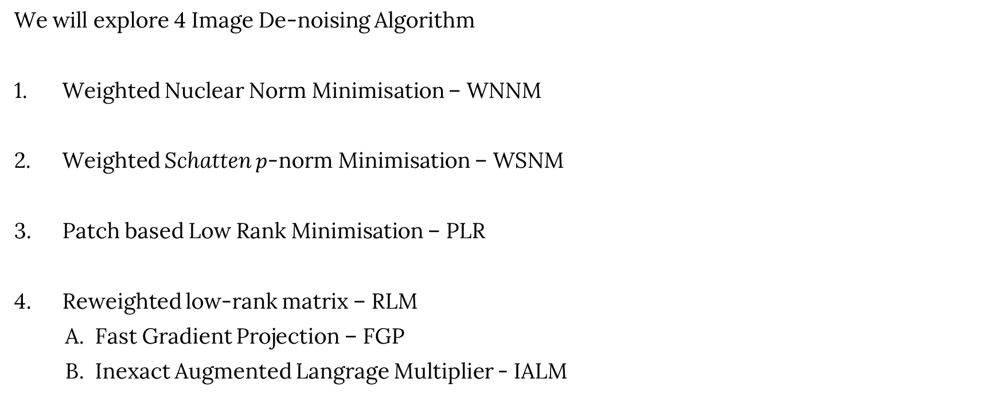
Introduction
We will explore 4 Image De-noising Algorithm
Weighted Nuclear Norm Minimisation – WNNM
Weighted Schatten $p$-norm Minimisation – WSNM
Patch based Low Rank Minimisation – PLR
Reweighted low-rank matrix – RLM
A. Fast Gradient Projection – FGP
B. Inexact Augmented Langrage Multiplier - IALM

Slide 7
Weighted Nuclear Norm Minimization WNNM
S. Gu, L. Zhang, W. Zuo, and X. Feng, “Weighted nuclear norm minimization with application to image denoising,” in $2014$IEEE Conference on Computer Vision and Pattern Recognition, $pp. 2862–2869, 2014.$

Slide 8
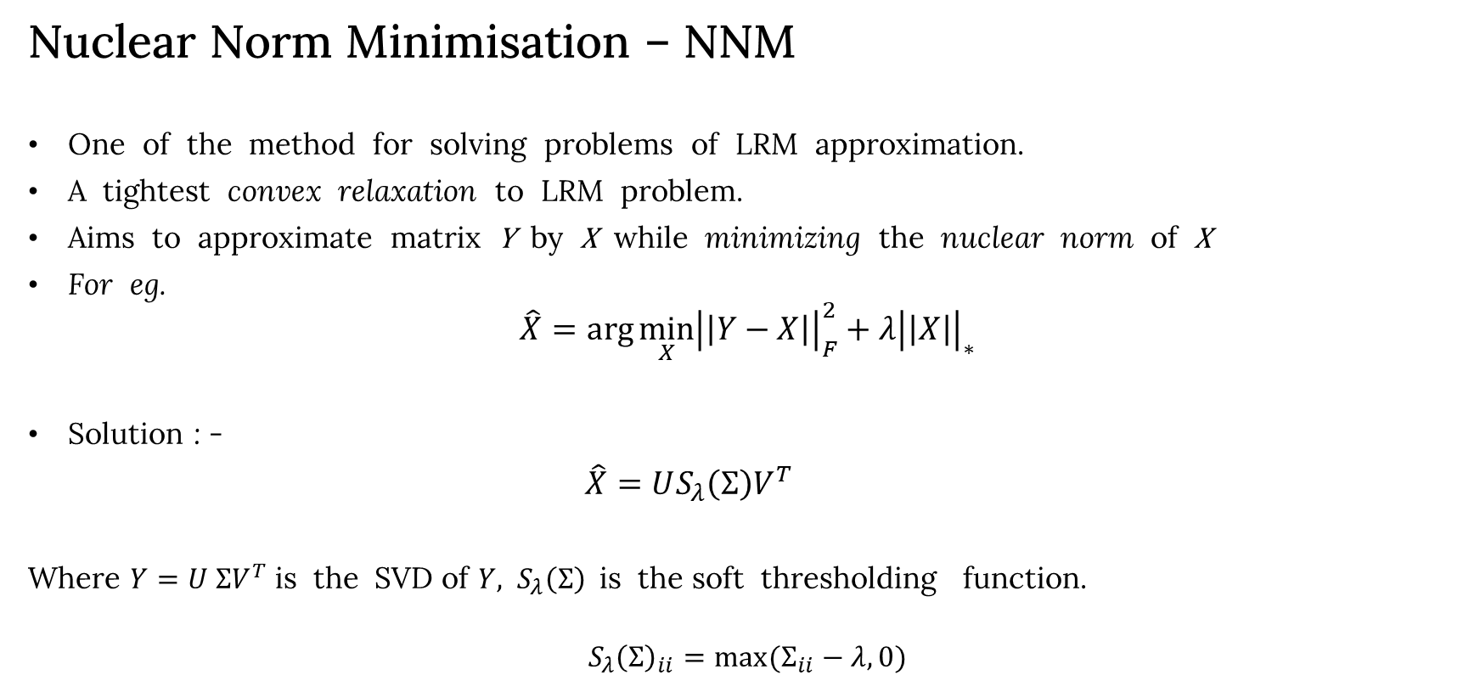
WNNM
Nuclear Norm Minimisation – NNM
One of the method for solving problems of LRM approximation.
A tightest convex relaxation to LRM problem.
Aims to approximate matrix Y by X while minimizing the nuclear norm of X
For eg.
$$\hat{X}=\arg{\min_{X}{{\left|\left|Y−X\right|\right|}_{F}^{2}+λ{\left|\left|X\right|\right|}_{∗}}}$$
Solution : -
$\hat{X}=US_{λ}\left(Σ\right)V^{T}$
Where $Y=U ΣV^{T}$is the SVD of $Y,$ $S_{λ}\left(Σ\right)$is the soft thresholding function.
$$S_{λ}{\left(Σ\right)}_{ii}=\max{(Σ_{ii}−λ,0)}$$

Slide 9
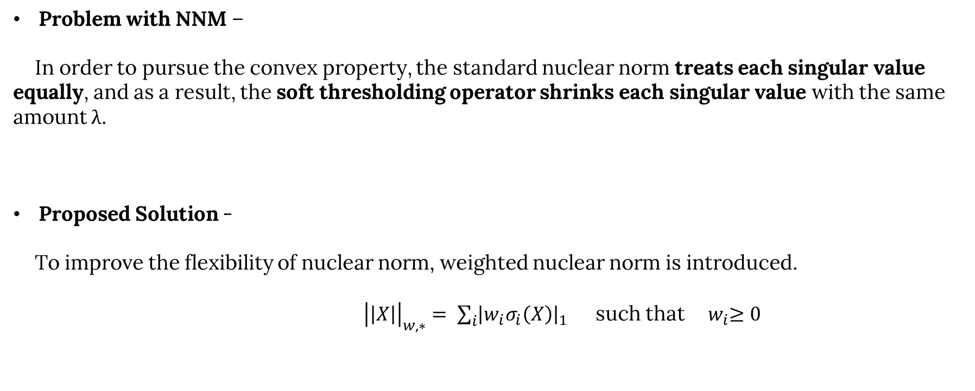
WNNM
Problem with NNM –
In order to pursue the convex property, the standard nuclear norm treats each singular value equally, and as a result, the soft thresholding operator shrinks each singular value with the same amount λ.
Proposed Solution -
To improve the flexibility of nuclear norm, weighted nuclear norm is introduced.
${\left|\left|X\right|\right|}_{w,∗}= \sum_{i}{{\left|w_{i}σ_{i}\left(X\right)\right|}_{1}}$ such that ${ w}_{i}≥0$

Slide 10
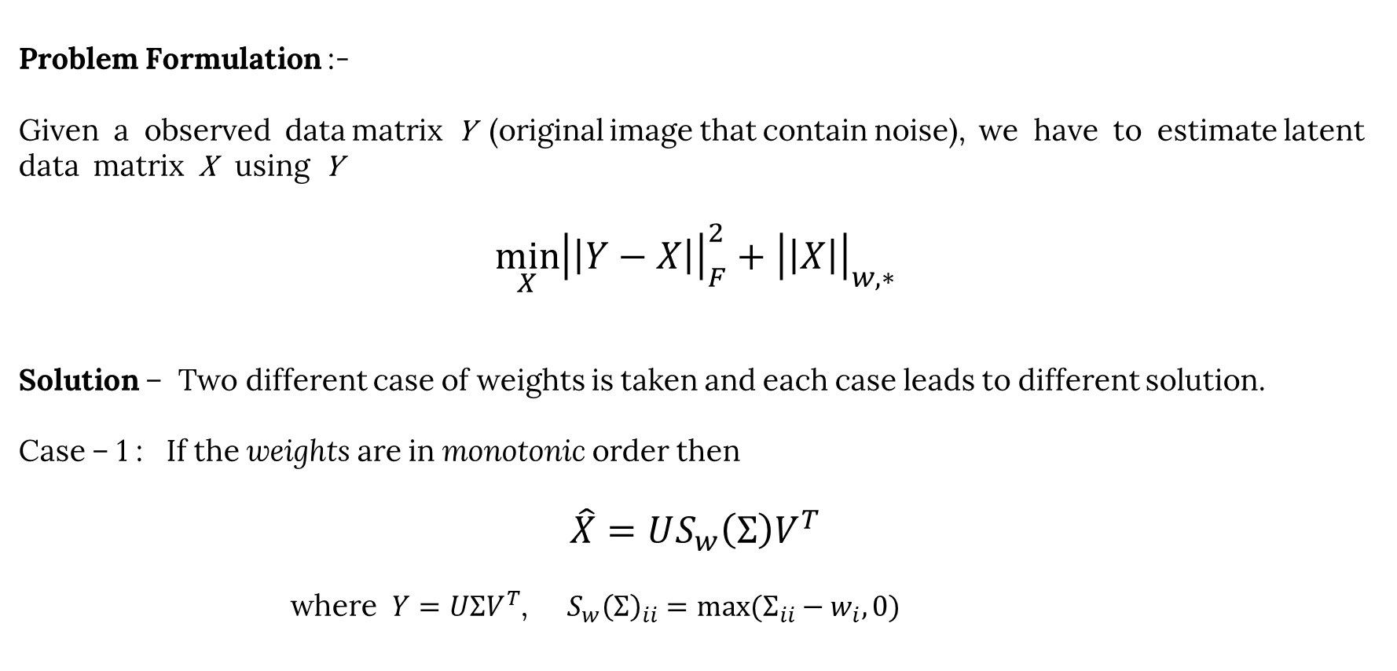
WNNM
Problem Formulation :-
Given a observed data matrix Y (original image that contain noise), we have to estimate latent data matrix X using Y
$$\min_{X}{{\left|\left|Y−X\right|\right|}_{F}^{2}+{\left|\left|X\right|\right|}_{w,∗}}$$
Solution – Two different case of weights is taken and each case leads to different solution.
Case – 1 : If the weights are in monotonic order then
$$\hat{X}=US_{w}\left(Σ\right)V^{T}$$
where $Y=UΣV^{T}$, $S_{w}{\left(Σ\right)}_{ii}=\max{(Σ_{ii}−w_{i},0)}$
10

Slide 11
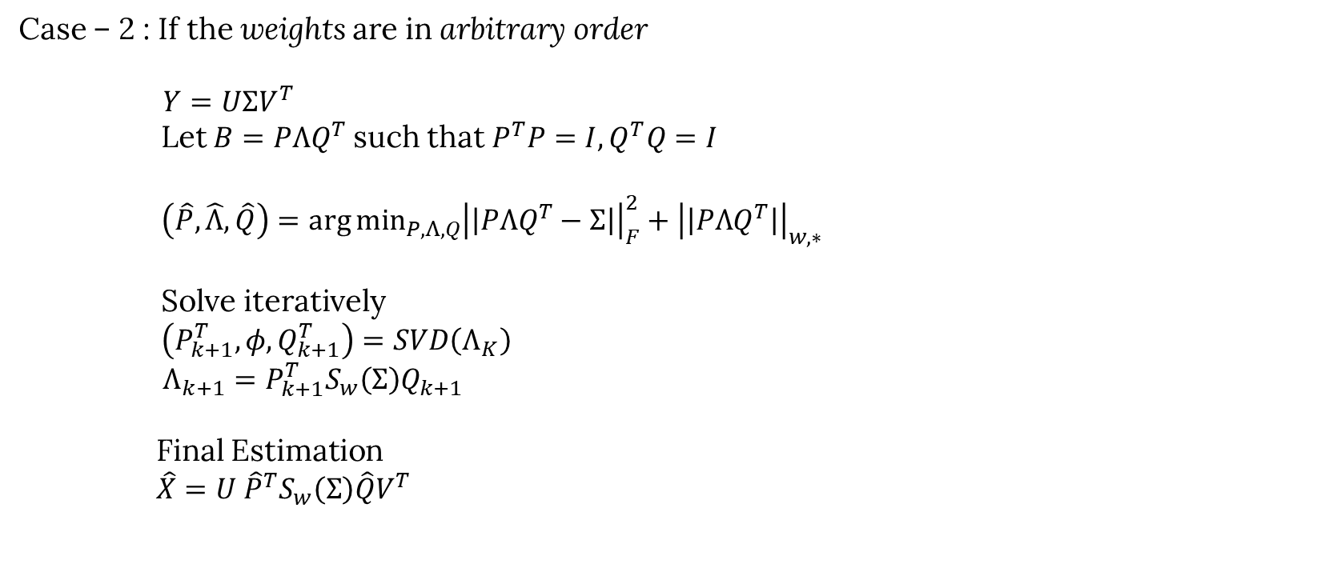
WNNM
Case – 2 : If the weights are in arbitrary order
$Y=UΣV^{T}$
Let $B=PΛQ^{T}$ such that $P^{T}P=I, Q^{T}Q=I$
$\left(\hat{P}, \hat{Λ},\hat{Q}\right)=\arg{\min_{P,Λ,Q}{{\left|\left|PΛQ^{T}−Σ\right|\right|}_{F}^{2}+{\left|\left|PΛQ^{T}\right|\right|}_{w,∗}}}$
Solve iteratively
$\left(P_{k+1}^{T},φ,Q_{k+1}^{T}\right)=SVD\left(Λ_{K}\right)$
$Λ_{k+1}=P_{k+1}^{T}S_{w}\left(Σ\right)Q_{k+1}$
Final Estimation
$\hat{X}=U {\hat{P}}^{T}S_{w}\left(Σ\right)\hat{Q}V^{T}$

Slide 12
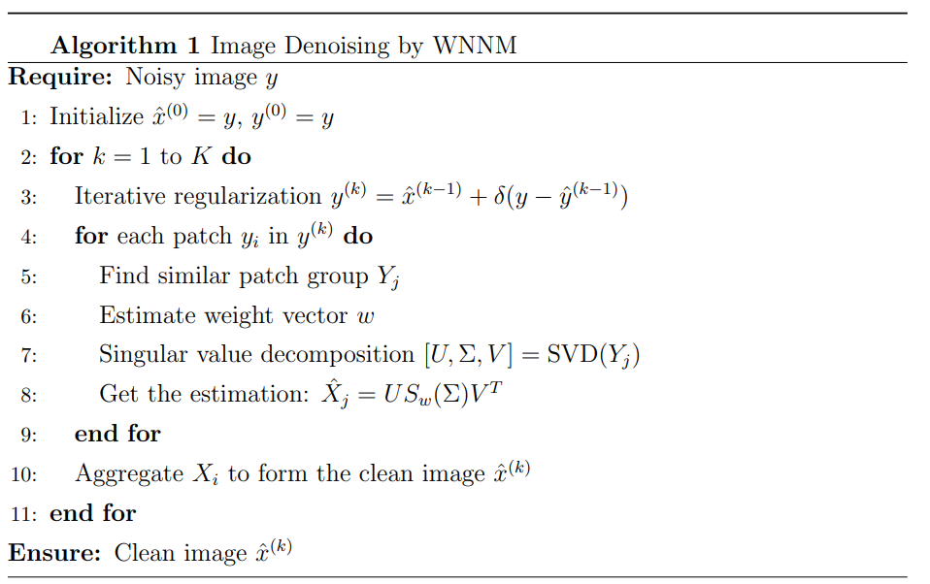
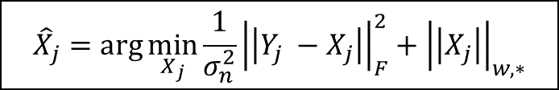
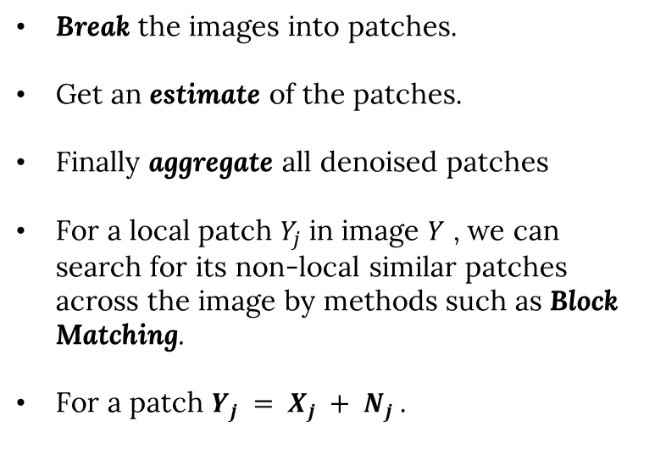
WNNM - Implementation
Break the images into patches.
Get an estimate of the patches.
Finally aggregate all denoised patches
For a local patch $Y_{j}$ in image $Y$ , we can search for its non-local similar patches across the image by methods such as Block Matching.
For a patch $Y_{j} = X_{j} + N_{j}$.
$${\hat{X}}_{j}=\arg{\min_{X_{j}}{\frac{1}{σ_{n}^{2}}{\left|\left|Y_{j} −X_{j}\right|\right|}_{F}^{2}+{\left|\left|X_{j}\right|\right|}_{w,∗}}}$$
12
12
Notes:
Sigma square n ko divide diya he to normalise thw fnorm

Slide 13

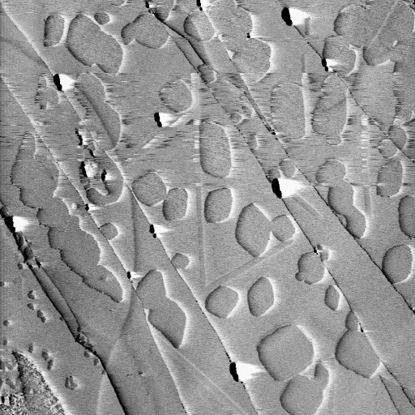
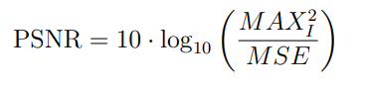
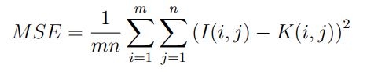
Experiment setting
Test Images :-
Image Accuracy Measure –
(a) (b) (c) (d)
House
Cameramen
Lena
Amplitude
Higher PSNR value indicates better image quality
where

Slide 14








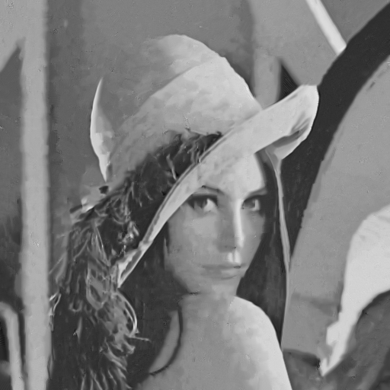

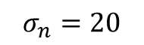
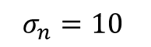
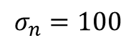
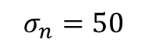
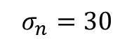
WNNM -Results
$$σ_{n}=10$$
$$σ_{n}=20$$
$$σ_{n}=30$$
$$σ_{n}=50$$
$$σ_{n}=100$$
Noise
Estimate
(a) (b) (c) (d) (e)
PSNR
36.66 db
33.07 db
31.26 db
28.73 db
25.54 db

Slide 15
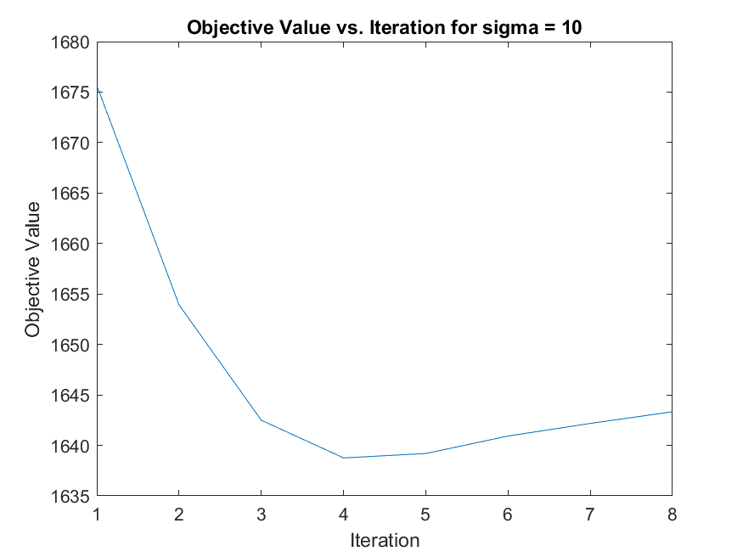
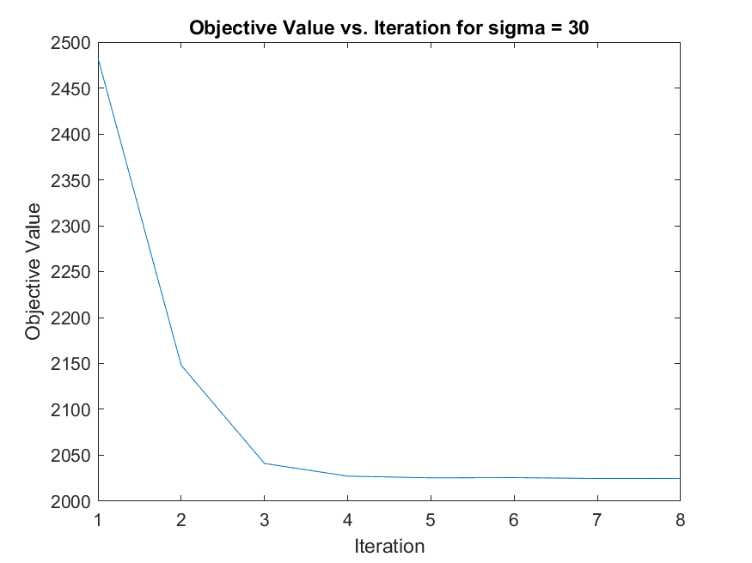
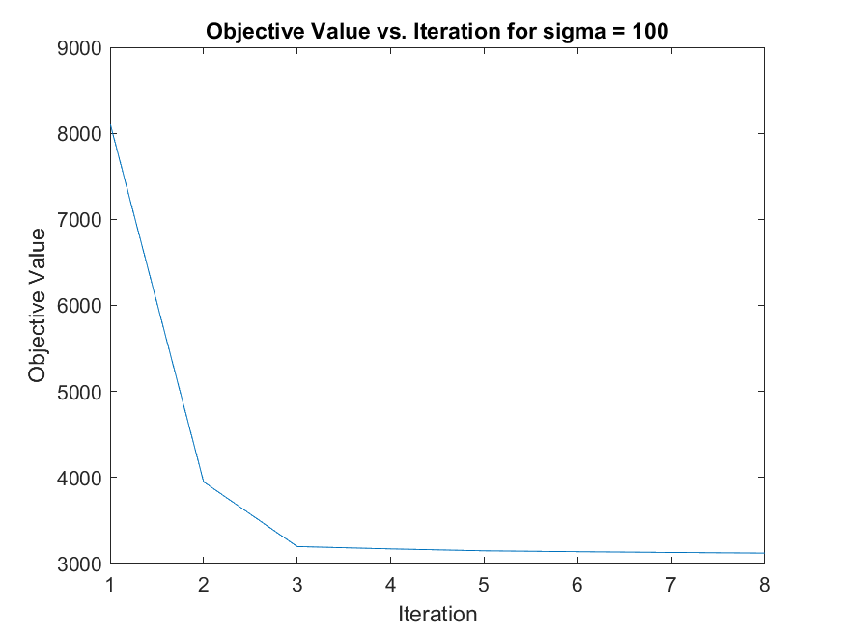
WNNM Results
Variation of main objective function after each iteration for Lena image

Slide 16
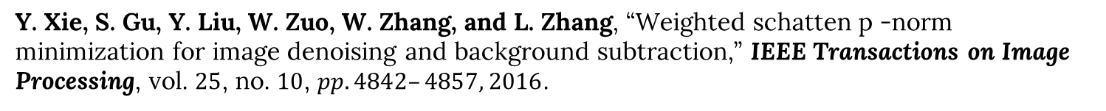
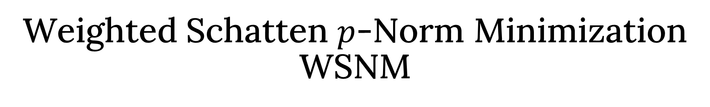
Weighted Schatten $p$-Norm Minimization WSNM
Y. Xie, S. Gu, Y. Liu, W. Zuo, W. Zhang, and L. Zhang, “Weighted schatten p -norm minimization for image denoising and background subtraction,” IEEE Transactions on Image Processing, vol. $25$, no. $10$, $pp. 4842–4857, 2016$.

Slide 17
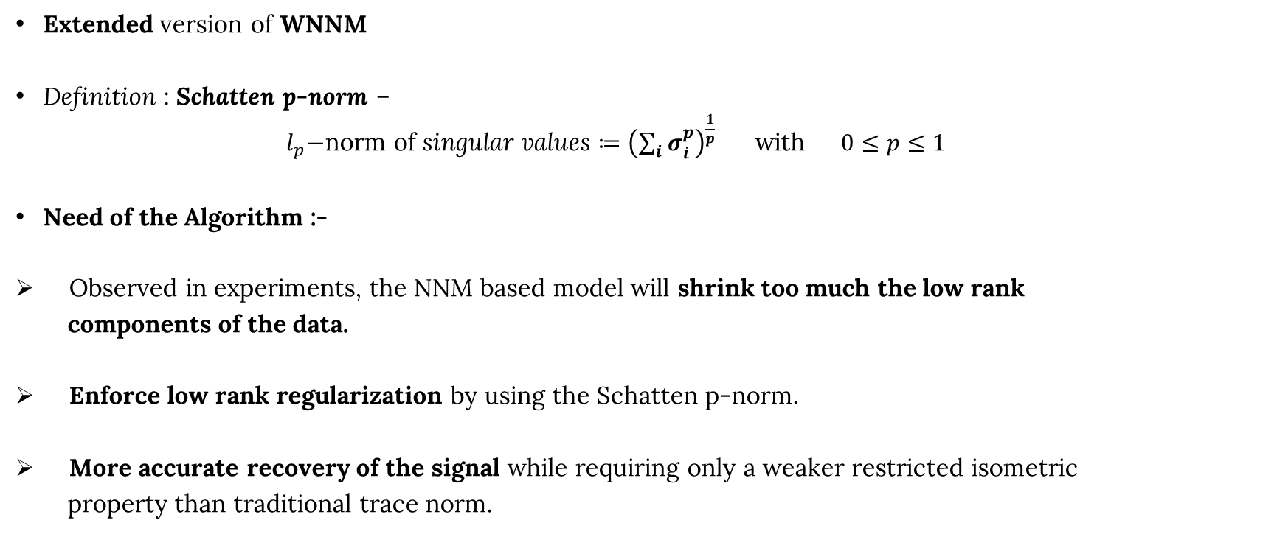
WSNM
Extended version of WNNM
Definition : Schatten p-norm –
${ l}_{p}−$norm of singular values $≔{\left(\sum_{i}{σ_{i}^{p}}\right)}^{\frac{1}{p}}$ with $0≤p≤1$
Need of the Algorithm :-
Observed in experiments, the NNM based model will shrink too much the low rank
components of the data.
Enforce low rank regularization by using the Schatten p-norm.
More accurate recovery of the signal while requiring only a weaker restricted isometric
property than traditional trace norm.

Slide 18
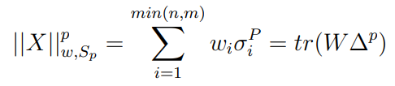
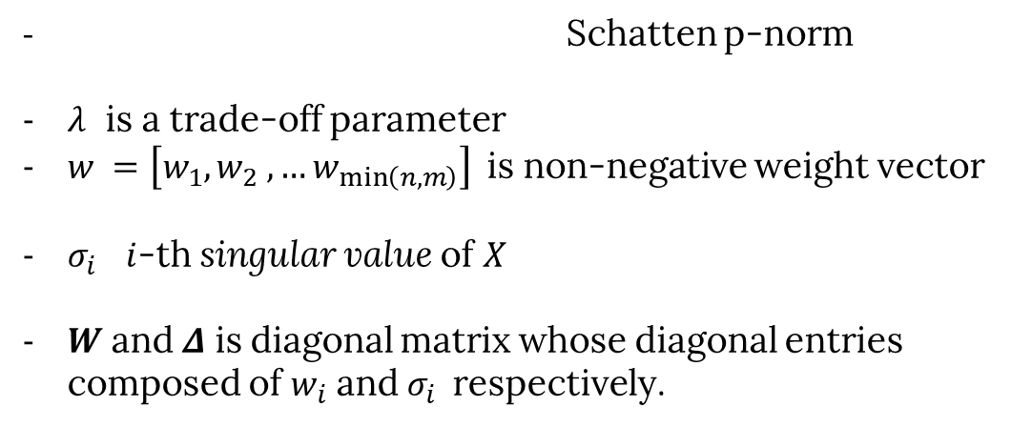
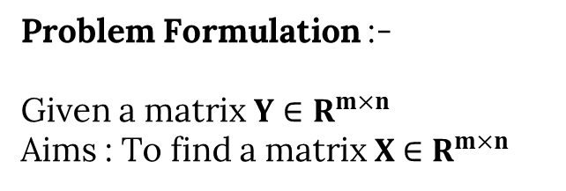

WSNM
Problem Formulation :-
Given a matrix $Y∈R^{m×n}$
Aims : To find a matrix $X$ $∈R^{m×n}$
$$\hat{X}=\arg{\min_{X}{{\left|\left|Y−X\right|\right|}_{F}^{2}+λ{\left|\left|X\right|\right|}_{w,S_{p}}^{p}}}$$
Where
- Schatten p-norm
$λ$ is a trade-off parameter
$w =\left[w_{1}, w_{2} , …w_{\min\left(n,m\right)}\right]$is non-negative weight vector
$σ_{i}$ $i$-th singular value of $X$
$W$ and $Δ$ is diagonal matrix whose diagonal entries composed of $w_{i}$ and $σ_{i}$respectively.

Slide 19
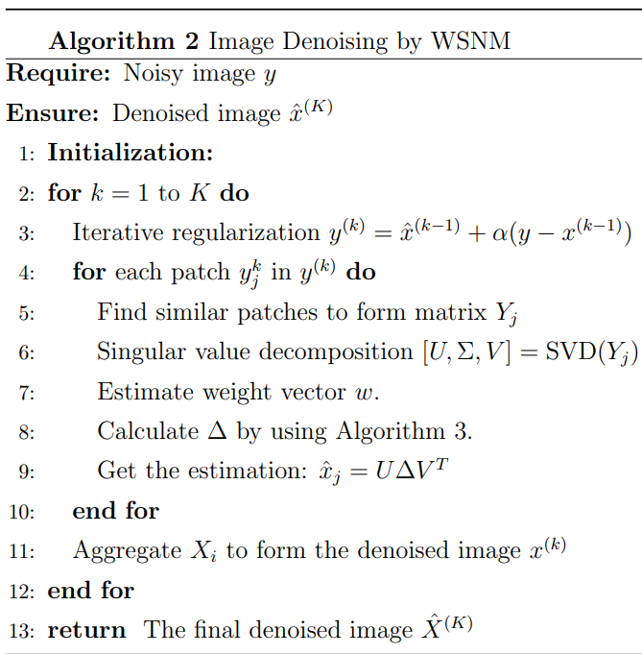
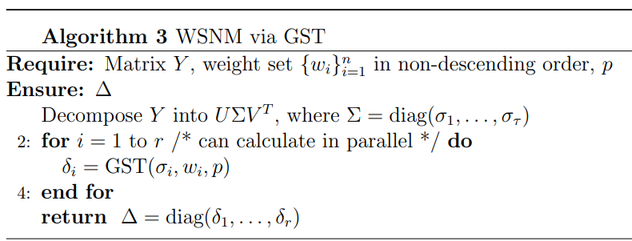
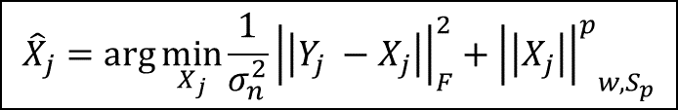
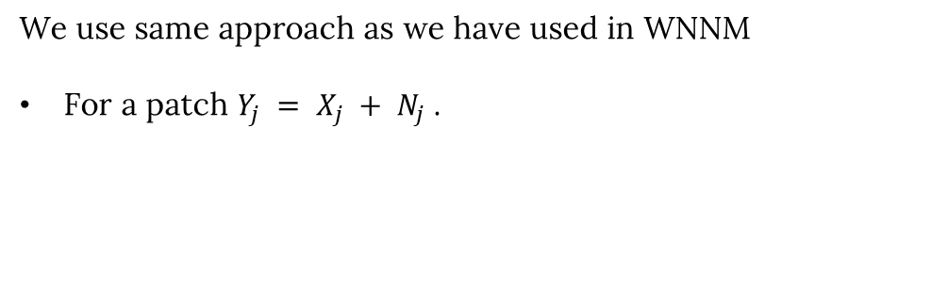
WSNM for Image De-noising
We use same approach as we have used in WNNM
For a patch $Y_{j} = X_{j} + N_{j}$.
$${\hat{X}}_{j}=\arg{\min_{X_{j}}{\frac{1}{σ_{n}^{2}}{\left|\left|Y_{j} −X_{j}\right|\right|}_{F}^{2}+{{\left|\left|X_{j}\right|\right|}^{p}}_{w,S_{p}}}}$$

Slide 20
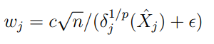
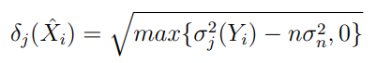
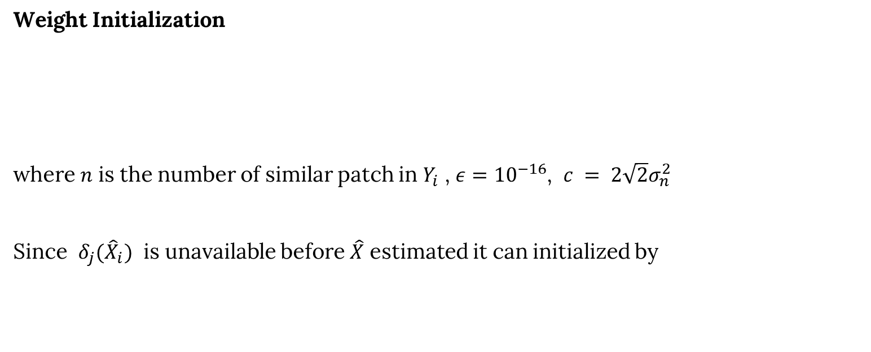
WSNM for Image De-noising
Weight Initialization
where $n$ is the number of similar patch in $Y_{i}$ , $ε={10}^{−16}$, $c = 2\sqrt{2}σ_{n}^{2}$
Since $δ_{j}({\hat{X}}_{i})$ is unavailable before $\hat{X}$ estimated it can initialized by

Slide 21
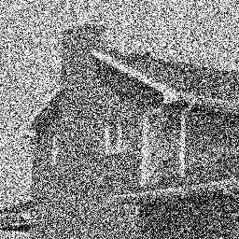
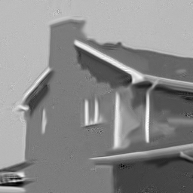
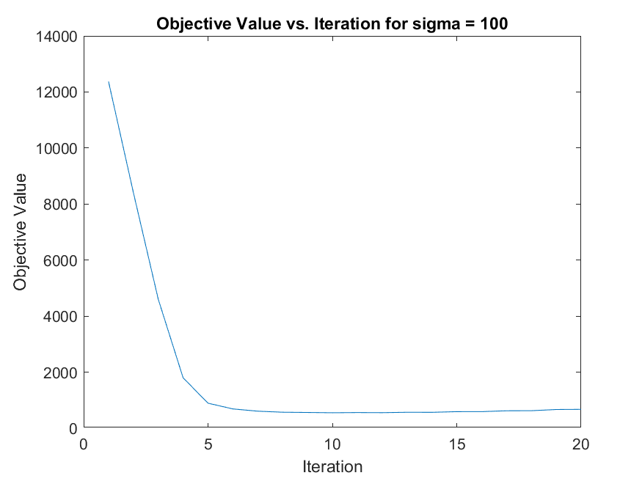
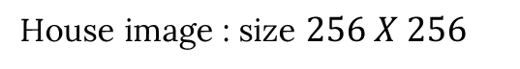
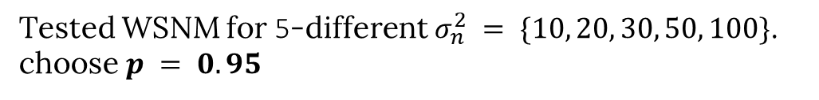
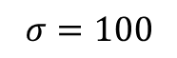
WSNM Results
Tested WSNM for 5-different $σ_{n}^{2} = \{10, 20, 30, 50, 100\}$. choose $p = 0.95$
House image : size $256 X 256$
$$σ=100$$
PSNR = 8.31 db
PSNR = 26.67 db
Variation of objective function

Slide 22
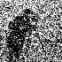
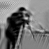
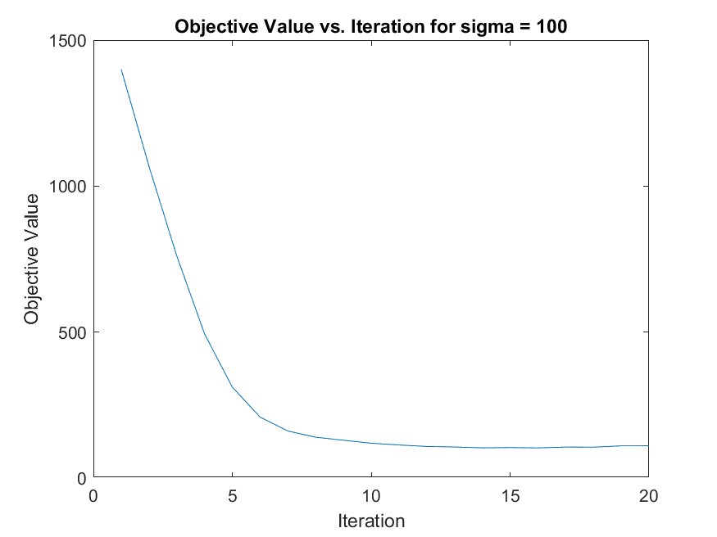
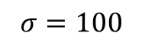
WSNM Results
Camera-men image : size $70 X 70$
$$σ=100$$
PSNR = 8.31 db
PSNR = 20.93 db
Variation of objective function

Slide 23
Patch-Based Low-Rank Minimization PLR
H. Hu, J. Froment, and Q. Liu, “A note on patch-based low-rank minimization for fast image denoising,” Journal of Visual Communication and Image Representation, vol. 50, pp. 100–110, 2018.

Slide 24
PLR - Introduction
Inspired by the inherent non-local self-similarity in natural images
Techniques like K-SVD, BM3D, WSNM, WNNM focus on small local patches
Cons - High computational cost due to iterative nature
PLR simplifies the denoise process by constructing similarity matrices from similar patches
Employing PCA (Principal Component Analysis)

Slide 25
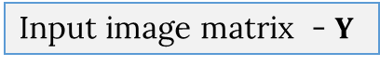
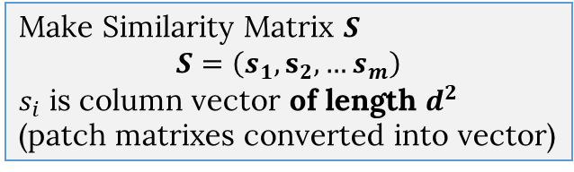
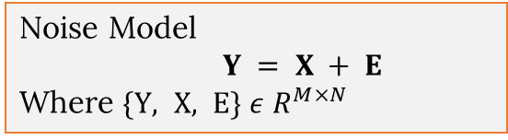



PLR - Method
Noise Model
$Y = X + E$
Where $\{Y, X, E\} ε$ $R^{M×N}$
Pre-processing steps
Input image matrix - $Y$
Divide the Y into overlapped Patches of size $d×d$
Denote Set of patches :
$χ=\{ x_{i} :i=1,2,…{\left(N−d+1\right)}^{2} \}$
$∀ each x∈χ$ (Reference Patch)
Consider all patches in its $n×n$neighbourhood
Denote it $φ$ s.t. $φ$ $⊂χ$ and #${φ= \left(n−d+1\right)}^{2}$
Choose $m$ most similar patch in $φ$
Using $F$-norm similarity
Make Similarity Matrix $S$
$$S=\left(s_{1},s_{2},…s_{m}\right)$$
$s_{i}$ is column vector of length $d^{2}$
(patch matrixes converted into vector)
25

Slide 26







Main steps
Similarity matrix - $S$
Assume mean of column, $s_{c}=\frac{1}{m} \sum_{l=1}^{m}{s_{l}=0}$
Noise Model
$Y = X + E$
Where $\{Y, X, E\} ε$ $R^{M×N}$
Derive PC basis of $SS^{T}$
$SS^{T}=PΛP^{−1}$ [EVD]
with $P=\left(g_{1},g_{2},…g_{d^{2}}\right)$,
$Λ=diag\left(mλ_{1}^{2},…mλ_{d^{2}}^{2}\right)$
Set of columns of $P$ is PC basis
Estimated patch of $s_{i}∈S,$ denoted as $\overline{s_{i}}$
$\overline{s_{i}}=\sum_{k=1}^{d^{2}}{a_{k}<s_{i}, g_{k}>g_{k}}$
Where $a_{k}=1$ if $λ_{k^{2}}^{2}>t^{2}$ ,
$\&$ $a_{k}=0$ otherwise,
- $t$ is threshold
$\overline{S} ≔\left(\overline{s_{1}},\overline{s_{2}},…\overline{s_{m}}\right)=Ph\left(Λ\right)P^{−1}$
Where $h\left(Λ\right)=diag(a_{1},a_{2},…a_{d^{2}})$
This method solution is same as solution of above LRM problem.
$\overline{S}$is the estimation of the $S$
Take average of all repeated estimated pixel in $S$ and aggregate them to obtain $X$
26

Slide 27

PLR Algo

Slide 28












PLR - Result
(a) (b)
(e) (f)
14.14 db
24.32 db
14.14 db
29.00 db
$$σ=50$$
$$σ=50$$
$$σ=30$$
$$σ=20$$
(c) (d)
(g) (h)
18.60 db
26.90 db
22.00 db
33.53 db
Set threshold $t=1.5σ$ , This threshold approximation is obtained theoretically

Slide 29
Reweighted Low-Rank Matrix Analysis RLM
H. Wang, Y. Cen, Z. He, Z. He, R. Zhao, and F. Zhang, “Reweighted lowrank matrix analysis with structural smoothness for image denoising,” IEEE Transactions on Image Processing, $vol. 27, no. 4, pp. 1777–1792, 2018$

Slide 30
RLM - Introduction
Why this method?
In existing Low rank matrix analysis methods image structural smoothness and pixel range constraints has not been carefully addressed.
Main contribution -
Add TV norm into the reweighted LRM model to maintain the smoothness of image structures.
Add pixel range constraint into the LRM model to regulate the recovery of image pixels
Authors developed a new numerical solution based on inexact augmented Lagrangian multipliers (IALM) and non-uniform singular value thresholding (NSVT).

Slide 31






RLM – Related Work & Definition
NNM based models
$\min_{X,E}{{|\left|X\right||}_{∗}+λ{|\left|E\right||}_{1}}$
s.t. $M=X+E$
2. Reweighted LRM model
$\min_{X,E}{{\left|\left|X\right|\right|}_{∗}+λ{\left|\left|W_{E} ⊙E\right|\right|}_{1}}$
s.t . $M = X + E$
3. TV norm based model
4. Operators
(a). Non-uniform soft thresholding (NST)
Let $X ∈ R^{m×n}$and $W ∈ R_{++}^{n}$ , then
(b). Non-uniform Singular value thresholding (NSVT)
$$\min_{X}{{\left|\left|X−M\right|\right|}_{F}^{2}+2ρ{\left|\left|X\right|\right|}_{TV}}$$
$$s.t. X∈B_{l,u} ≡\{ x_{i,j}, l≤x_{i,j}≤u\}$$

Slide 32


RLM – Problem Formulation
$M$ – original noise image
$X$ - denoised image
$E$- noise
$\left\{M,X,E,W_{E}\right\}∈R^{m×n}$ , $W_{X}∈R^{n} ,η ,λ$ – regularization parameter
Objective Function

Slide 33









PLR solution
Iterative alternating direction method
Optimising H
Optimising X
Optimising E
Optimizing $Y_{1},Y_{2}$
This is calculated using FGP Algorithm

Slide 34



PLR Algorithm
Beck and M. Teboulle, “Fast gradient-based algorithms for constrained total variation image denoising and deblurring problems,” IEEE Transactions on Image Processing, $vol. 18, no. 11, pp. 2419–2434, 2009.$
X. M. Yuan and J. F. Yang, “Sparse and low-rank matrix decomposition via alternating direction methods,” Online, $2009$.

Slide 35


Algorithm
In FGP
Set $λ=0.1$ and $N=2$
In Algorithm 5 – Main algo
Set $maxiter=\left\{1,2,3\right\}$ , $ε_{X}=ε_{E}=0.01$
In Algorithm 6 – IALM
Set $λ=1/\sqrt{\max\left(m,n\right)}$ , $η=\text{0.0025/}\sqrt{\max\left(m,n\right)}$
$δ=1.5$ ,
$$X_{0}=E_{0}=H_{0}=0$$
$Y_{1,0}=M/\max{(\left|\left|M\right|\right|,λ^{−1}{\left|\left|M\right|\right|}_{∞})}$
$Y_{2,0}=0$
$inneriter=100$

Slide 36
















Results
$$σ=40$$
1. 2. 3. 4. 5.
6. 7. 8. 9. 10.
11. 12. 13. 14. 15.

Slide 37


RLM -Results
Important points –
As per parameter setting given in paper, In algo-1 objective function attain a minima in IALM before entering while loop, also it does not enter in while loop it already satisfy the condition of while loop. For entering in while loop I change the $ε$ value.
In algo-1, maxiter =1 , After entering into while loop, algo-1 passed to algo-2. In algo-2 I did not get any result. After testing I had found that inneriter should be 12-13 instead of 100. After that image start disappearing.
On the right side, plot of variation of objective function given after each iteration of while loop of algo-2 ( for prev slide result).
I found that even after taking log value, I
get exponential curve. This implies that our
objective function is maximised rather than
minimise.

Slide 38






RLM -Results
(a) (b) (c)
FGP
IALM
For further check I have implemented FGP and IALM algorithm separately and check, they are working fine (results in this slide). Variation of obj function in FGP at $N=2$ attain minima which is right as per our setting, but in IALM obj function increases rapidly then attain saturation. This might be reason for prev curve, although authors IALM (algorithm -2) is just an modification of main IALM method.
(d) (e)

Slide 39
RLM -Results
After implementation of PLR, I did not get desired results so we discard this algorithm from our experiments instead of this I have used its sub-component algorithms FGP and IALM for experiment.
In this method there are problem in parameter settings and it may be possible that we have to change the update rule in both algorithms.
Although this method not works but we are sure that there is a way to solve image de-noise problem using this approach.

Slide 40
Comparison-Conclusion

Slide 41



Comparison

Slide 42


Comparison

Slide 43
Observation
Results of WNNM and WSNM are approximately similar, one possible reason is that we use p = 0.95 which is close to 1 and at p = 1 WSNM is same as WNNM.
On Microscopic Image, results of WSNM and WNNM are not good as Lena image, perhaps both of same size. We can say that WSNM and WNNM not so good for microscopic images.
PLR method stands out for its computational efficiency. Experiments demonstrate that the proposed method is rather rapid, and it is effective for a variety of natural grayscale images and color images.
PLR results are competing with WSNM and WNNM.
FGP and IALM results similar but not good as WNNM and WSNM

Slide 44
Conclusion
Successfully implemented and tested the performance of denoising algorithms such as WNNM, WSNM and PLR.
Identified and fixed critical bugs in existing online code for WNNM, WSNM, and PLR.
Developed the code for RLM and FGP (Component of RLM) from scratch.
Conducted a thorough analysis of the RLM algorithm, identifying and rectifying inaccuracies in parameter settings from the original academic publications.
Codes, experiments results and other stuffs related to project can be found in drive link –
https://drive.google.com/drive/folders/1FxAmoZugIMYcgozbiQRZjCW2oDbi0gH2?usp=sharing

Slide 45
Future Scope
De-noise colour image by taking each matrix of RGB channel with consideration of correlation between those matrix.
Further investigation into the RLM algorithm

Slide 46





Reference

Slide 47
Thank You

